Slide 1
LIFESTYLE DISEASE PREDICTION
PIP104 PROFESSIONAL PRACTICE-II
VIVA-VOCE
Batch Number: CSD13
Roll Number | Student Name
FAIZ KHAN | 20201CSD0115
JEEVITH JOSEPH | 20201CSD0111
TEJAS GOWDA | 20201CSD0072
Under the Supervision of,
Dr.CHANDRASEKAR V
Professor , School of Computer Science Engineering & Information Science
Presidency University

Slide 2
Introduction
In an era where data and technology are transforming every aspect of our lives, healthcare is no exception. With the rising prevalence of lifestyle-related diseases, such as diabetes, heart disease, and obesity, the need for innovative and cost-effective preventive healthcare solutions has never been more pressing. Early detection and intervention are key to reducing the human and economic toll of these diseases.
This project sets out to explore a novel approach to healthcare that harnesses the power of detailed demographic and vital statistics to predict the likelihood of lifestyle diseases, enabling timely interventions and substantial cost savings in the long run. This project will help the user to overcome the lifestyle diseases which are in themselves a big threat to humans, will reduce the unawareness about the diseases and will help people to remain healthy which is of utmost importance in today’s fast-growing world. In this project, we will delve into the methods and technologies necessary to harness the potential of data driven predictive modeling in healthcare. By integrating technology, data, and medical expertise, we aim to pave the way for a healthcare system that not only extends lives but also makes them healthier and more affordable. This proactive approach holds the promise of not only enhancing the quality of life for individuals but also reducing the economic burden of lifestyle diseases on healthcare systems worldwide.
Among the prominent lifestyle diseases, this exploration delves into the complexities of diabetes, heart disease, chronic kidney disease, and pneumonia. Each of these conditions is not only shaped by genetic predispositions but also intricately connected to the way individuals live their lives

Slide 3
Literature Review
[1] Diabetes Prediction Using Ensemble of Different Machine Learning Classifiers2020Md. Kamrul Hasan, Md. Ashraful Alam, Dola Das, Eklas Hossain, (Senior Member, IEEE), and Mahmudul Hasan (2020), had proposed a robust framework for diabetes prediction where the outlier rejection, filling the missing values, data standardization, feature selection, K-fold cross-validation, and different Machine Learning (ML) classifiers like knearest Neighbor, Decision Trees, Random Forest, AdaBoost, Naive Bayes, and XGBoost and Multilayer Perceptron (MLP) were employed.
[2] Krishnaiah et al , reviewed the various data mining algorithms used for predicting heart disease. They studied the various approaches used in different papers. Their findings showed different accuracy by taking different number of features and methods which are used for implementation. It was observed from their study that the Fuzzy Intelligent Techniques increased the accuracy of the prediction system.
[3]Chitra et al [2], for predicting heart disease used Supervised Learning Algorithm. The results were compared with SVM.A Cascaded Neural Network (CNN) classifier is used to classify the record of the patient. To calculate the risk of the disease 13 attributes are given to the CNN classifier as input. The dataset contained records collected from 270 patients. The results showed a better accuracy for the CNN classifier than the known SVM classifier LIFESTYLE DISEASE PREDICTION USING MACHINE LEARNING AND DEEP LEARNING School of Computer Science & Engineering , Presidency University.
[4]Chronic Kidney Disease Prediction Using Machine Learning Models .Year: October 2019 Author: Revathy, S., Bharathi, B., Jeyanthi, P., & Ramesh, M. Journal Name: Chronic kidney disease prediction using machine learning models. International Journal of Engineering and Advanced Technology: In this paper This paper presented a prediction algorithm to predict CKD at an early stage. The dataset shows input parameters collected from the CKD patients and the models are trained and validated for the given input parameters. Decision tree, Random Forest and Support Vector Machine learning models are constructed to carry out the diagnosis of CKD. The performance of the models are evaluated based on the accuracy of prediction.
[5]D. Meldon, Nimesh Naik ,The primary objective of this study is to analyze the patients X- ray images using OpenCV and Deep learning and decide whether the patient has pneumonia or not.We created a deep learning model to aid and address this inconvenient situation for radiologists to achieve the patient's results which can be analyzed and reported to the patient directly. They have used Keras libraries and OpenCV for achieving a high test data accuracy rate.

Slide 4
Research Gaps Identified
Research Gap 11: Integrated Model for Multiple Diseases: Explore the development of an integrated predictive model that simultaneously considers risk factors for heart disease, diabetes, chronic kidney disease, and pneumonia. This could involve a multi-task learning approach or an ensemble model that combines individual disease prediction models. [4]
Research Gap 12: Limited Emphasis on Explainability in Lifestyle Disease Prediction Issue The interpretability and explainability of lifestyle disease prediction models are often given insufficient attention. Details: Existing models may lack transparency in decisionmaking, potentially impacting trust and acceptance among healthcare professionals and individuals [2]
Research Gap 13: Underexplored Ensemble Approaches in Lifestyle Disease Prediction There is limited exploration of ensemble methods in predicting lifestyle diseases, such as diabetes and heart disease. Details: While some studies acknowledge the potential of ensemble techniques , a more comprehensive investigation is needed to understand their effectiveness, optimal combinations, and impact on enhancing model robustness. [1]
Research Gap 14: Limited Incorporation of Demographic and Socioeconomic Factors in Lifestyle Disease Prediction Models Issue : Many lifestyle disease prediction models may not sufficiently incorporate demographic and socioeconomic factors. Details: The literature review highlights a gap in understanding how demographic and socioeconomic variables impact the performance and prediction accuracy of models in the context of lifestyle-related diseases. [2]

Slide 5
Proposed Methodology
Data Collection and Preparation [1] : – Gather a comprehensive dataset that includes demographic information and vital statistics of individuals, along with their lifestyle disease status (e.g., diabetes, heart disease). – Ensure data quality, accuracy, and privacy compliance by anonymizing and securing sensitive information. – Split the dataset into training and testing sets for model development and evaluation.
• Feature Selection and Engineering: – Identify relevant features from the dataset, such as age, gender, BMI, blood pressure, cholesterol levels, and lifestyle habits (e.g., smoking, physical activity, diet). – Perform feature engineering to create new variables or transform existing ones, if necessary, to improve predictive accuracy.
• Machine Learning Model Development: – Implement machine learning algorithms suitable for classification tasks, such as logistic regression, decision trees, random forests, or support vector machines. – Train the models on the training dataset using the selected features. – Evaluate model performance using metrics like accuracy, precision, recall, and F1-score, and select the most appropriate model.
• Website Integration: – Develop a user-friendly website that incorporates a user friendly interface for interacting with users. Allow users to input their parameters, including age, gender, BMI, and other vital statistics.
• Disease Prediction Module: – Integrate the trained machine learning model into the website interface. – On user input, pass the parameters to the model, which will then predict the likelihood of lifestyle diseases based on the provided data. – Provide users with a clear and interpretable prediction, indicating their risk of developing specific diseases

Slide 6
Objectives
Lifestyle disease prediction models serve several critical objectives in the realm of public health. One primary goal is the early detection and prevention of non-communicable diseases (NCDs). By identifying individuals at risk during the early stages, these models enable timely intervention and implementation of preventive measures.
Early Detection and Prevention: Lifestyle disease prediction models tailor health strategies based on an individual's unique lifestyle and health profile. By providing targeted recommendations for lifestyle modifications, these models empower individuals to make informed decisions about their well-being.
Health promotion : It is also a crucial objective of lifestyle disease prediction. By raising awareness about the profound impact of lifestyle choices on health, these models contribute to a cultural shift toward healthier behaviors. Individuals gain insights into their disease risk factors, encouraging them to adopt healthier lifestyles and thereby reducing the overall burden of lifestyle diseases on society.
Data-Driven Decision Making: The continuous monitoring facilitated by these models ensures a real-time tracking of changes in lifestyle and health parameters. This feature provides regular updates on an individual's disease risk, allowing for timely adjustments to preventive strategies and fostering a dynamic, adaptable healthcare approach.

Slide 7
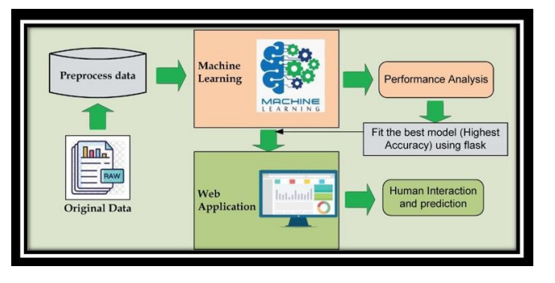
System Design & Implementation

Slide 8
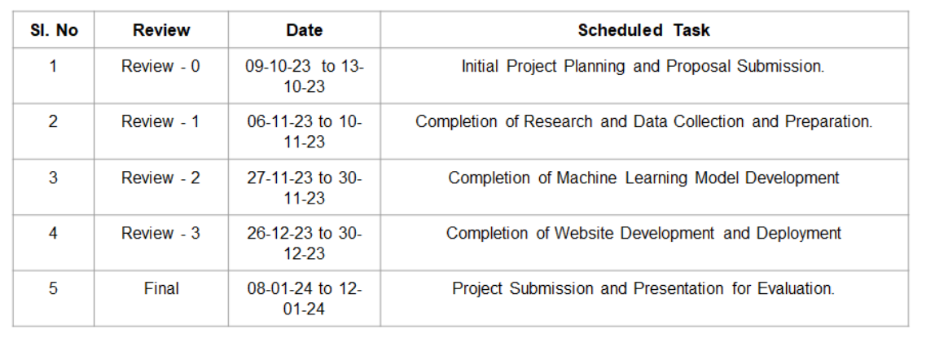
Timeline of Project

Slide 9
Outcomes / Results Obtained
1. Identification of Optimal Algorithms:
Objective: Determine the best-performing machine learning algorithms for heart disease prediction[3].
Explanation: Through a comprehensive comparative analysis, this outcome allows for the identification of algorithms that demonstrate superior performance in accurately predicting heart disease risks. Healthcare professionals can leverage this information to choose models that align with their specific clinical requirements, optimizing diagnostic accuracy and patient care.
2. Performance Metrics Insights:
Objective: Provide detailed insights into performance metrics for each algorithm.
Explanation: This outcome offers a deeper understanding of performance metrics (such as accuracy, precision, recall, etc.) for each machine learning algorithm used in heart disease prediction.
3. Model Interpretability:
Objective: Offer insights into the interpretability of machine learning models.
Explanation: This outcome focuses on explaining how each algorithm generates predictions, ensuring that healthcare professionals can comprehend and trust the model's decision making process. By providing insights into model interpretability, such as feature importance or decision rationale, it enhances the transparency and trustworthiness of the predictive models.

Slide 10
Conclusion
The application of machine learning, particularly in the form of predictive models, for lifestyle disease prediction has demonstrated significant potential across various health domains. In the case of diabetes, heart disease, chronic kidney disease, and pneumonia, these models offer valuable tools for early detection, intervention, and personalized healthcare.
In conclusion, the utilization of machine learning in predicting lifestyle diseases proves transformative for healthcare. These models empower healthcare professionals with predictive insights, enabling early interventions, personalized treatment plans, and improved patient outcomes. As technology continues to advance, the integration of artificial intelligence in healthcare holds the promise of a more proactive, precise, and patient-centered approach to disease prevention and management. However, it is essential to address ethical considerations, data privacy, and ensure continuous refinement of these modelsthrough collaborative research and validation in real-world healthcare settings

Slide 11
References
[1] Shraddha Subhash Shirsath, Prof. Shubhangi Patil Disease Prediction Using Machine Learn.Over Big Data”. International Journal of Innovative Research in Science, Engineering and Technology, [2018]. ISSN (Online) : 2319-8753, ISSN (Print) : 2347- 6710.
[2] Vinitha S, Sweetlin S, Vinusha H, Sajini S. “Disease Prediction Using Machine Learning Over Big Data”. Computer Science & Engineering: An International Journal (CSEIJ), Vol.8, No.1, [2018]. DOI:10.5121/cseij.2018.8101.
[3] Sayali Ambekar and Dr.Rashmi Phalnikar. “Disease Prediction by using Machine Learning”. International journal of computer engineering and applications, Volume XII, special issue, May 18. ISSN: 2321-3469.
[4] Lohith S Y, Dr. Mohamed Rafi. “Prediction of Disease Using Learning over Big Data - Survey”. International Journal on Future Revolution in Computer Science & Communication Engineering. ISSN:2454-4248.
[5] J. Senthil Kumar, S. Appavu. “The Personalized Disease Prediction Care from Harm using Big Data Analytics in Healthcare”. Indian Journal of Science and Technology, vol 9(8), DOI:10.17485/ijst/2016/v9i8/87846, [2016]. ISSN (Print): 0974-6846, ISSN (Online): 0974-5645.

Slide 12

Thank You

